Slide 1
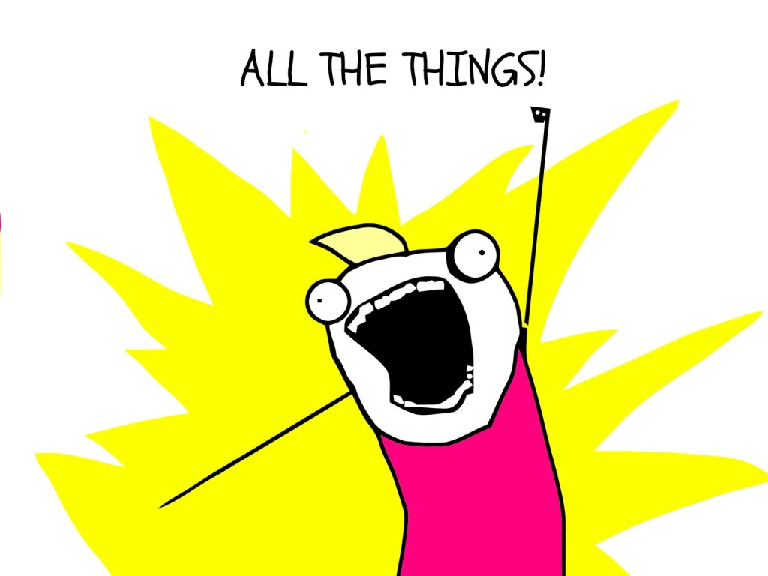
NPM CLI:

Slide 2
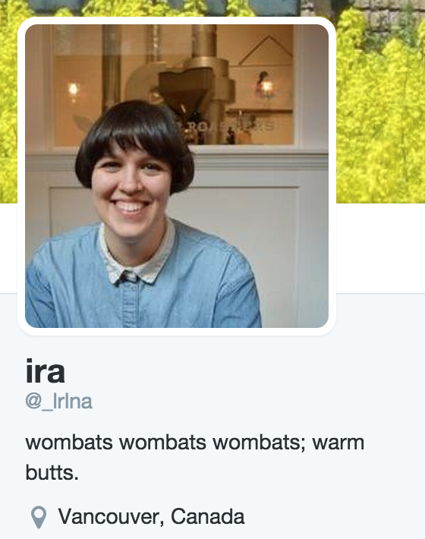
Hello, my name is:
@lrlna
Software Dev @ Monstercat (meowww)
IRL:
Mentor @ Ladies Learning Code

Slide 3

DISCLOSURE!

Slide 4
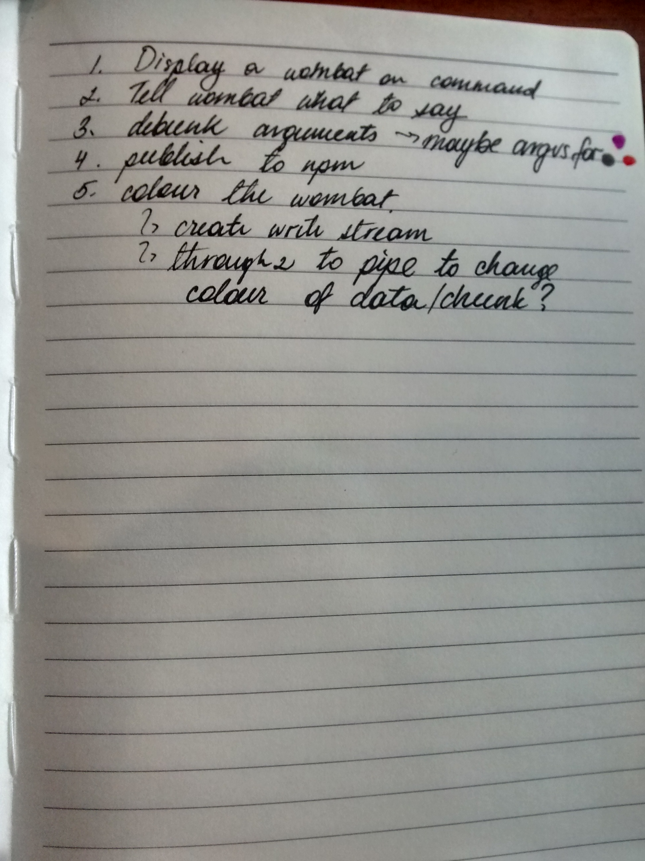
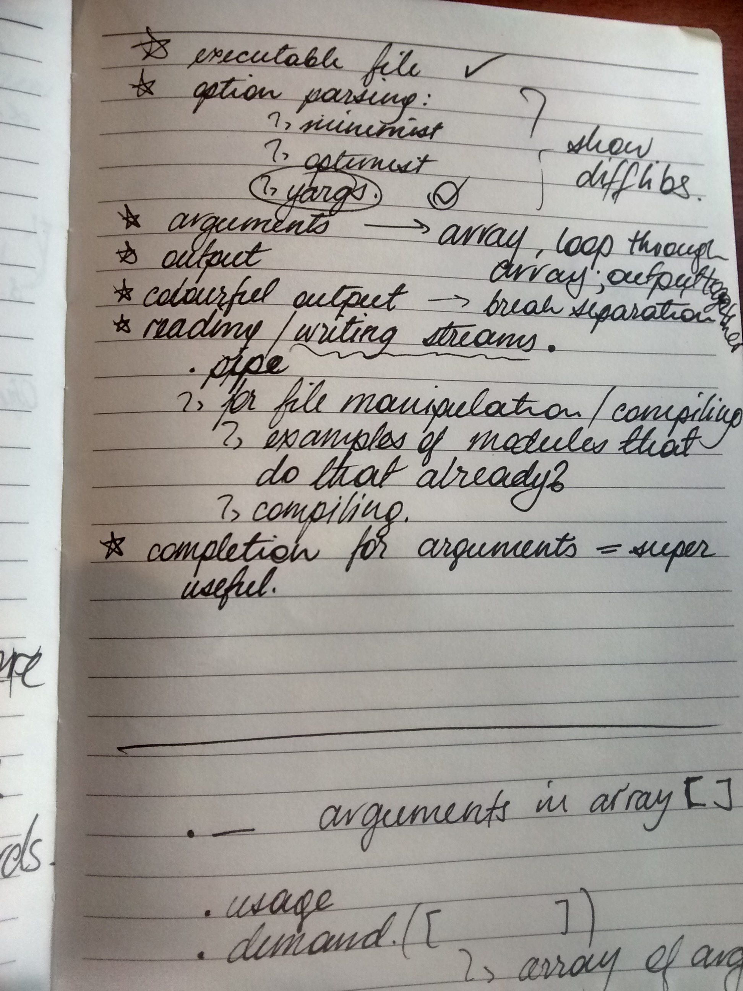

Slide 5
Here is what we are building!

Slide 6
CLI Basics
Executable File
Options/Commands
Arguments
COLOUR!
Completing Arguments
Publishing

Slide 7
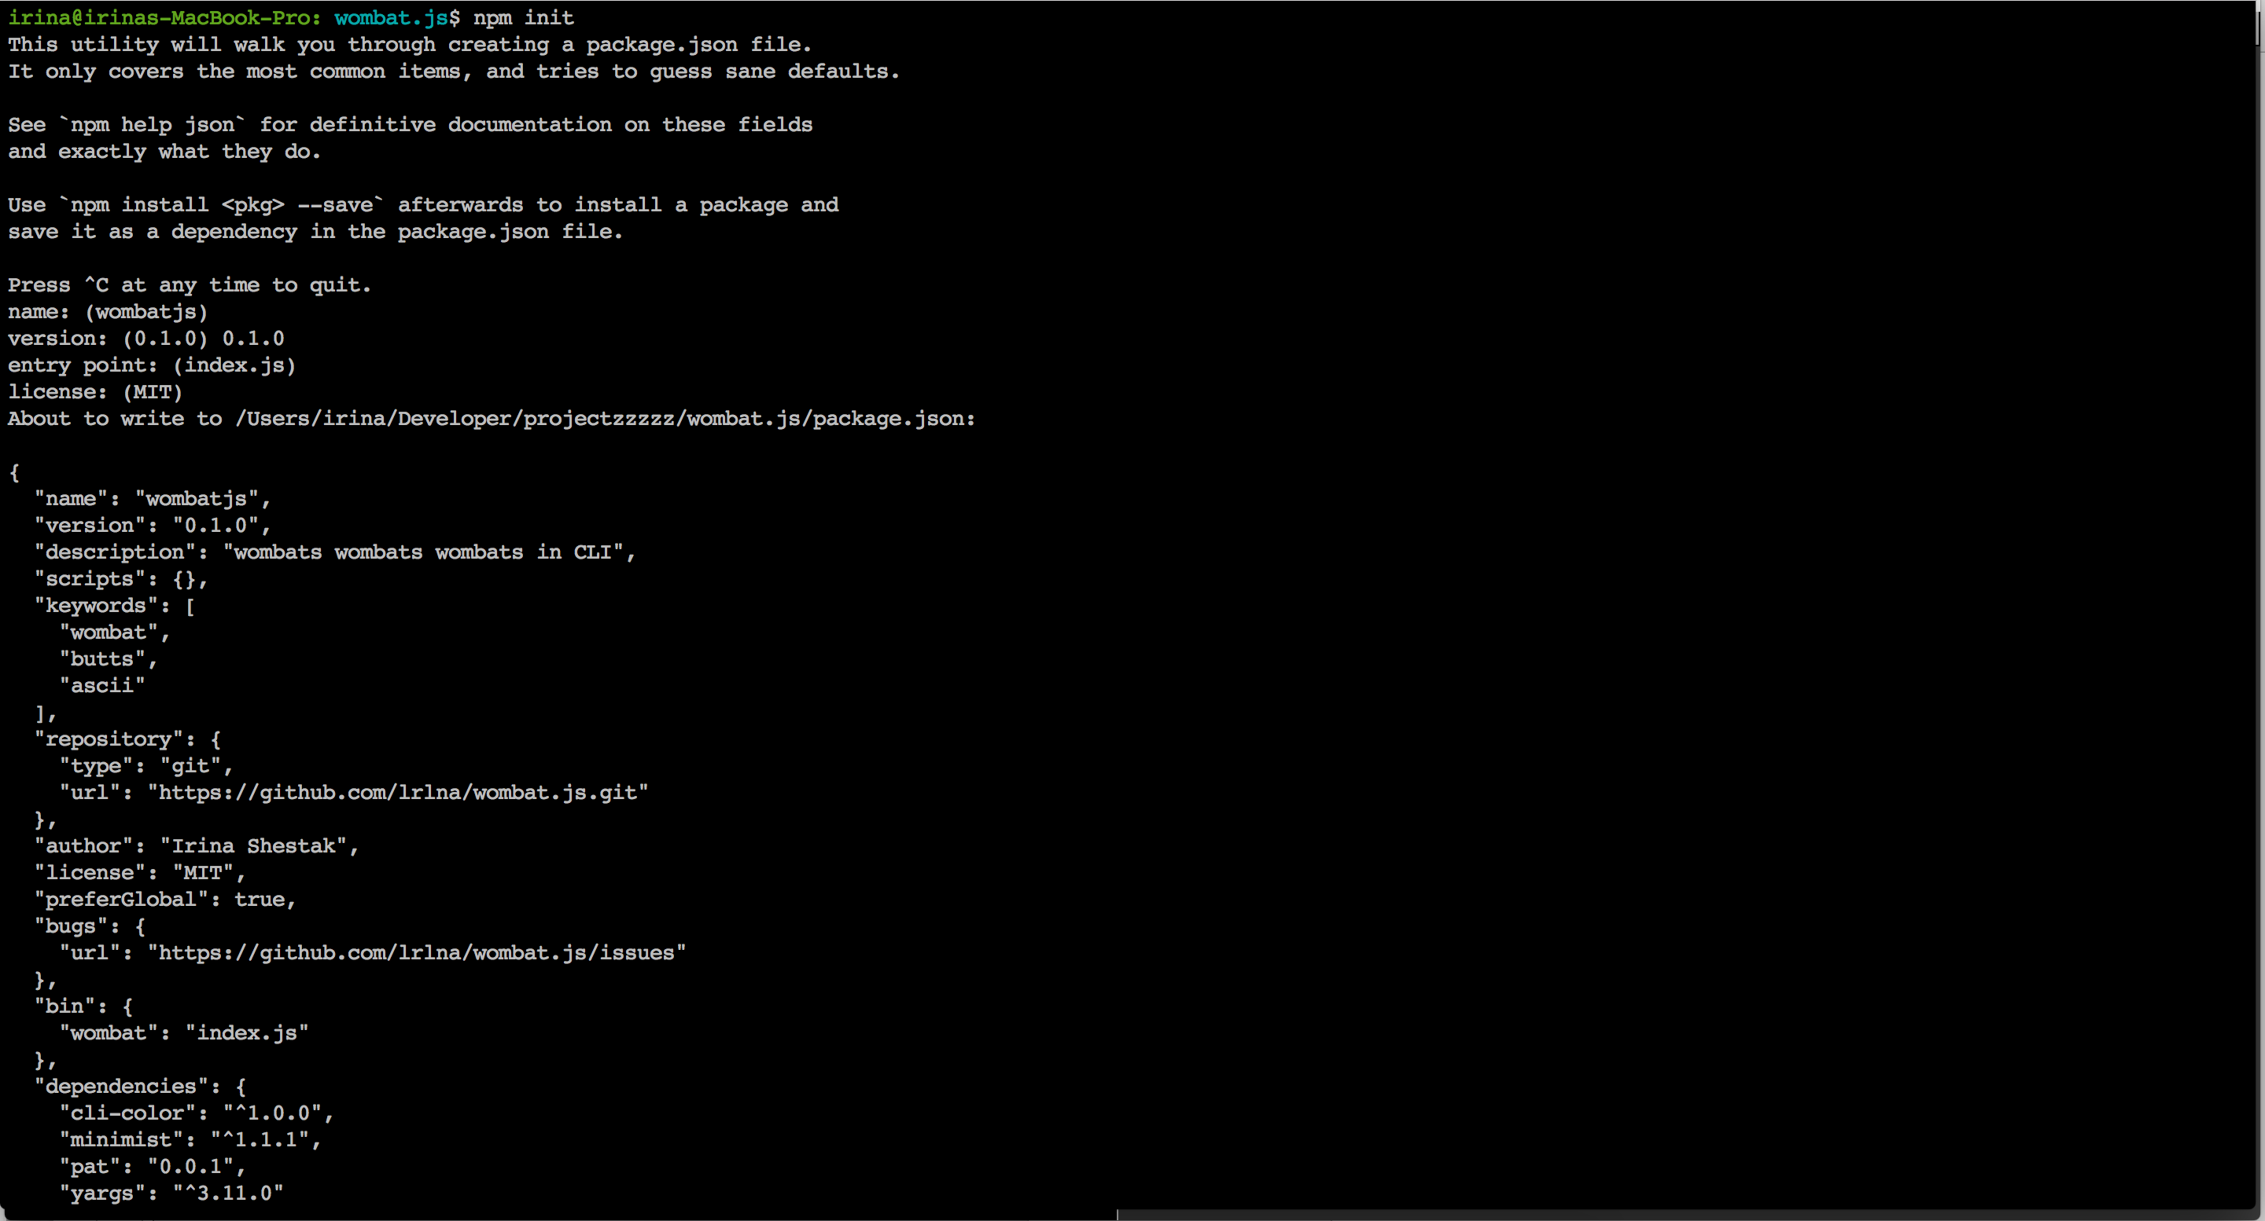
Starting Off:
npm init

Slide 8
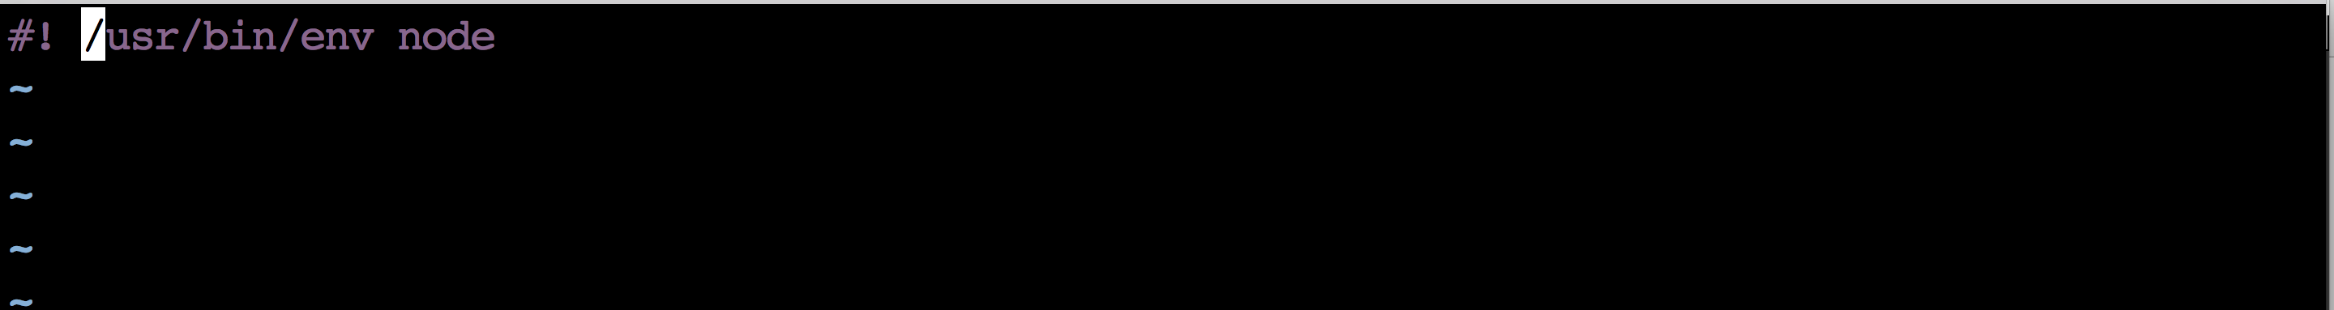
Starting off:
Executable File

Slide 9
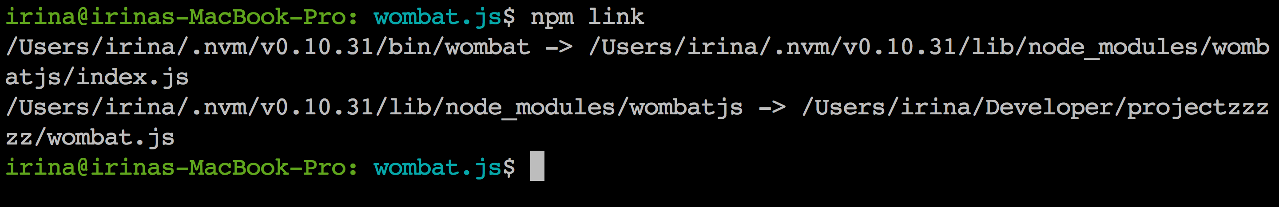
Starting off:
Executable File
npm link

Slide 10
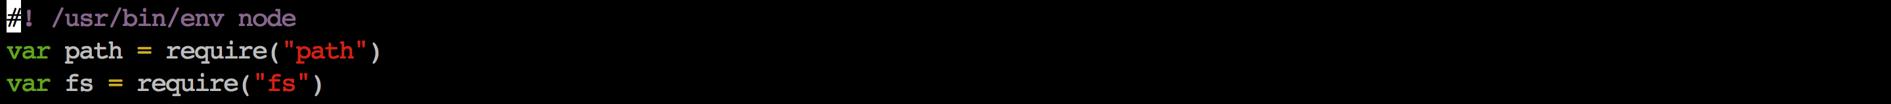
Reading files!

Slide 11
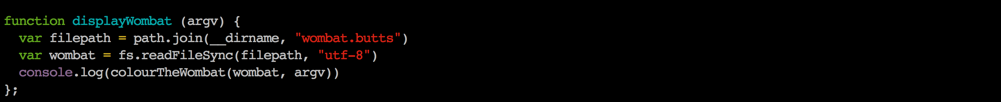
Reading files!

Slide 12
Option + Argument Parsing!
Minimist
Optimist
Yargs
Others?

Slide 13
Option + Argument Parsing!
Minimist
Optimist
Yargs
Others?

Slide 14
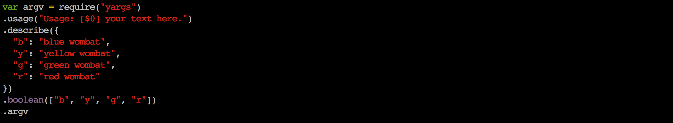
Using the arguments!

Slide 15
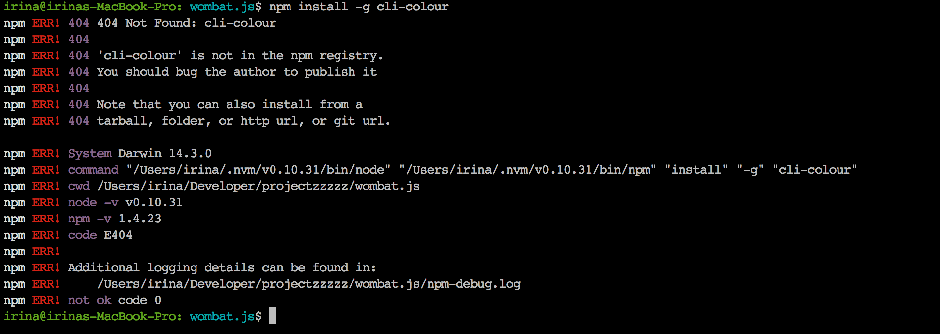
ALL THE COLOURS
cli-colour

Slide 16
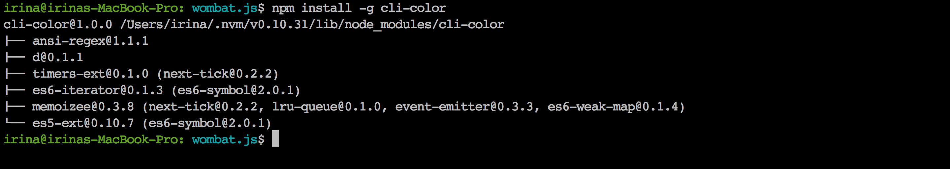
ALL THE COLOURS
cli-colour cli-color

Slide 17

ALL THE COLOURS
cli-colour cli-color
and magic!

Slide 18
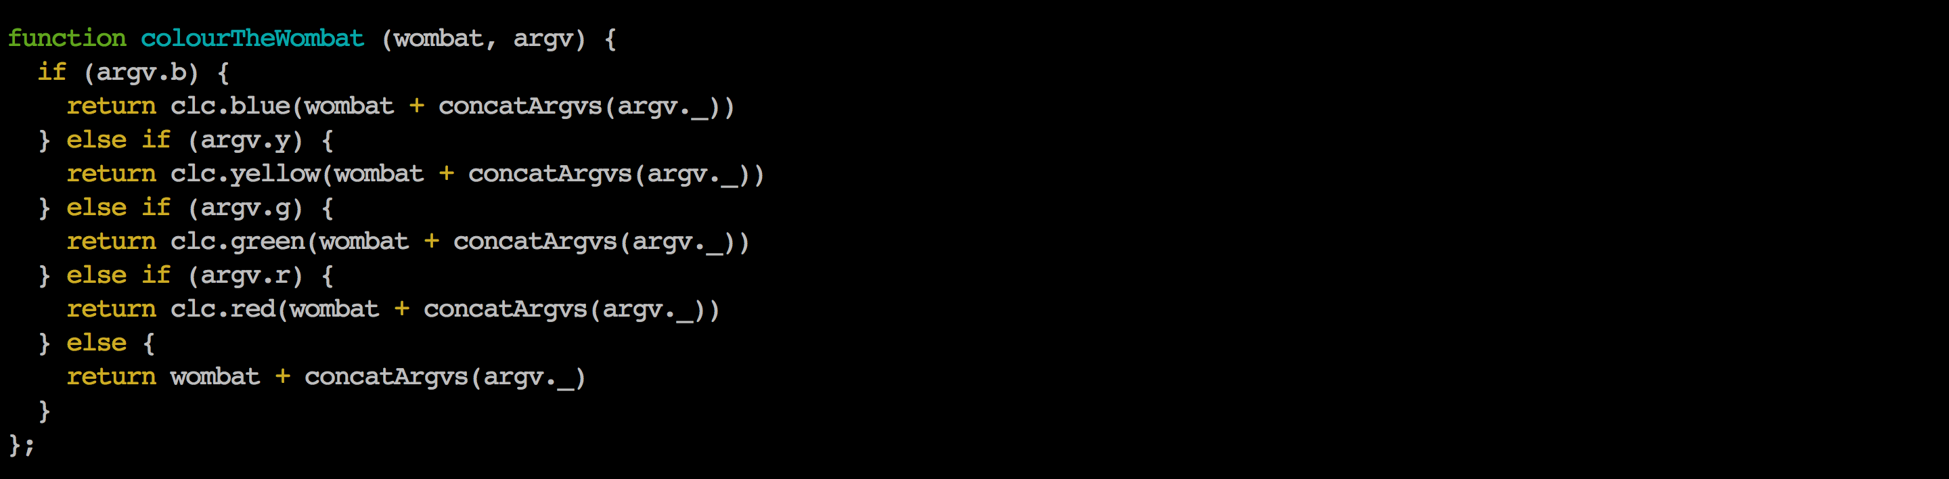
Use the colour

Slide 19
Publishing.
Super complicated procedure is….

Slide 20
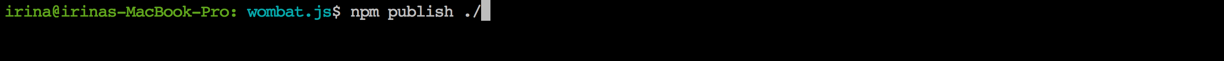
Publishing.
Super complicated procedure is….

Slide 21
But what do I need CLI things for?

Slide 22
Resources
RESOURCES:
https://gist.github.com/lrlna/06c25c7bb7096d50a1b5
Your own wombat at home:
npm install wombatjs

